Slide 1
.NET/C# Training
Parthiban
17/11/2023
Notes:
This template can be used as a starter file for presenting training materials in a group setting.
Sections
Right-click on a slide to add sections. Sections can help to organize your slides or facilitate collaboration between multiple authors.
Notes
Use the Notes section for delivery notes or to provide additional details for the audience. View these notes in Presentation View during your presentation.
Keep in mind the font size (important for accessibility, visibility, videotaping, and online production)
Coordinated colors
Pay particular attention to the graphs, charts, and text boxes.
Consider that attendees will print in black and white or grayscale. Run a test print to make sure your colors work when printed in pure black and white and grayscale.
Graphics, tables, and graphs
Keep it simple: If possible, use consistent, non-distracting styles and colors.
Label all graphs and tables.

Slide 2
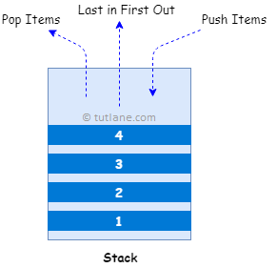
C# Stack
LIFO (Last in, First out)
Stack stk = new Stack();
Notes:
Give a brief overview of the presentation. Describe the major focus of the presentation and why it is important.
Introduce each of the major topics.
To provide a road map for the audience, you can repeat this Overview slide throughout the presentation, highlighting the particular topic you will discuss next.

Slide 3
C# Stack Properties
Property | Description
Count | It will return the total number of elements in a stack.
IsSynchronized | It is used to get a value to indicate whether access to the stack is synchronized (thread-safe) or not.

Slide 4
C# Stack Methods
Method | Description
Push | It is used to insert an object at the top of a stack.
Pop | It will remove and return an object at the top of the stack.
Clear | It will remove all the elements from the stack.
Clone | It will create a shallow copy of the stack.
Contains | It is used to determine whether an element exists in a stack or not.
Peek | It is used to return a top element from the stack.

Slide 5
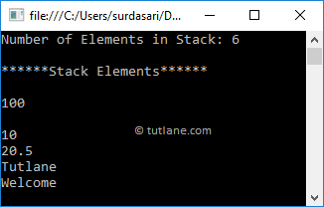
Stack stk = new Stack();
stk.Push("Welcome");
stk.Push("Tutlane");
stk.Push(20.5f);
stk.Push(10);
stk.Push(null);
stk.Push(100);
Console.WriteLine("Number of Elements in Stack: {0}", stk.Count);
Console.WriteLine("******Stack Elements******");
// Access Stack Elements
foreach (var item in stk)
{
Console.WriteLine(item);
}
Console.ReadLine();

Slide 6
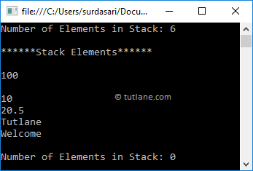
Stack stk = new Stack();
stk.Push("Welcome");
stk.Push("Tutlane");
stk.Push(20.5f);
stk.Push(10);
stk.Push(null);
stk.Push(100);
Console.WriteLine("Number of Elements in Stack: {0}", stk.Count);
Console.WriteLine("******Stack Elements******");
// Access Stack Elements
while (stk.Count > 0)
{
Console.WriteLine(stk.Pop());
}

Slide 7
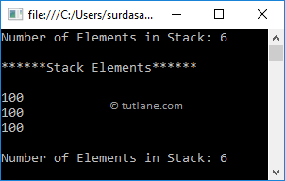
// Create and initialize a stack
Stack stk = new Stack();
stk.Push("Welcome");
stk.Push("Tutlane");
stk.Push(20.5f);
stk.Push(10);
stk.Push(null);
stk.Push(100);
Console.WriteLine("Number of Elements in Stack: {0}", stk.Count);
Console.WriteLine("******Stack Elements******");
// Access Stack Elements
Console.WriteLine(stk.Peek());
Console.WriteLine(stk.Peek());
Console.WriteLine(stk.Peek());
Console.WriteLine("Number of Elements in Stack: {0}", stk.Count);
Console.ReadLine();

Slide 8
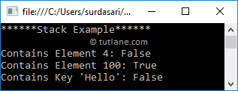
Stack stk = new Stack();
stk.Push("Welcome");
stk.Push("Tutlane");
stk.Push(20.5f);
stk.Push(10);
stk.Push(null);
stk.Push(100);
Console.WriteLine("******Stack Example******");
Console.WriteLine("Contains Element 4: {0}", stk.Contains(4));
Console.WriteLine("Contains Element 100: {0}", stk.Contains(100));
Console.WriteLine("Contains Key 'Hello': {0}", stk.Contains("Hello"));

Slide 9
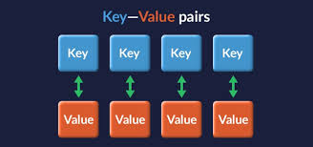
C# HashTable
store a key/value pair elements of different data type
Hashtable htbl = new Hashtable();
Key | Value
code | 101
Train | Vaigai
State | TN
Country | India

Slide 10
Property | Description
Count | It is used to get the number of key/value pair elements in the hashtable.
IsFixedSize | It is used to get a value to indicate whether the hashtable has a fixed size or not.
IsReadOnly | It is used to get a value to indicate whether the hashtable is read-only or not.
Item | It is used to get or set the value associated with the specified key.
IsSynchronized | It is used to get a value to indicate whether access to the hashtable is synchronized (thread-safe) or not.
Keys | It is used to get the collection of keys in the hashtable.
Values | It is used to get the collection of values in the hashtabl

Slide 11
Method | Description
Add | It is used to add an element with a specified key and value in a hashtable.
Clear | It will remove all the elements from the hashtable.
Clone | It will create a shallow copy of the hashtable.
Contains | It is useful to determine whether the hashtable contains a specific key or not.
ContainsKey | It is useful to determine whether the hashtable contains a specific key or not.
ContainsValue | It is useful to determine whether the hashtable contains a specific value or not.
Remove | It is useful to remove an element with a specified key from the hashtable.
GetHash | It is useful to get the hash code for the specified key.

Slide 12
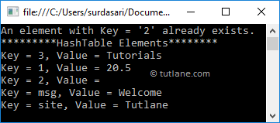
Hashtable htbl = new Hashtable(); htbl.Add("msg", "Welcome"); htbl.Add("site", "Tutlane"); htbl.Add(1, 20.5); htbl.Add(2, null); // Another way to add elements. If the key does not exist, then that key adds a new key/value pair. htbl[3] = "Tutorials";
foreach (DictionaryEntry item in htbl) { Console.WriteLine("Key = {0}, Value = {1}", item.Key, item.Value); }

Slide 13
Hashtable htbl = new Hashtable(){
{"msg", "Welcome"},
{"site", "Tutlane"},
{1, 20.5},
{2, null}
};

Slide 14
Hashtable htbl = new Hashtable();
htbl.Add("msg", "Welcome");
htbl.Add("site", "Tutlane");
htbl.Add(1, 20.5f);
htbl.Add(2, 10);
string msg = (string)htbl["msg"];
float num = (float)htbl[1];
Console.WriteLine("*********Access Elements with Keys********");
Console.WriteLine("Value at Key 'msg': " + msg);
Console.WriteLine("Value at Key '1': " + num);
Console.WriteLine("*********Access Elements with Foreach Loop********");
foreach (DictionaryEntry item in htbl)
{
Console.WriteLine("Key = {0}, Value = {1}", item.Key, item.Value);
}
Console.WriteLine("*********HashTable Keys********");
foreach (var item in htbl.Keys)
{
Console.WriteLine("Key = {0}", item);
}
Console.WriteLine("*********HashTable Values********");
foreach (var item in htbl.Values)
{
Console.WriteLine("Value = {0}", item);
}
Console.ReadLine();

Slide 15
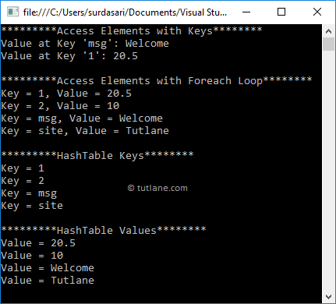

Slide 16
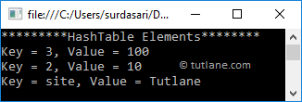
Hashtable htbl = new Hashtable();
htbl.Add("msg", "Welcome");
htbl.Add("site", "Tutlane");
htbl.Add(1, 20.5f);
htbl.Add(2, 10);
htbl.Add(3, 100);
// Removing hashtable elements with keys
htbl.Remove(1);
htbl.Remove("msg");
Console.WriteLine("*********HashTable Elements********");
foreach (DictionaryEntry item in htbl)
{
Console.WriteLine("Key = {0}, Value = {1}", item.Key, item.Value);
}

Slide 17
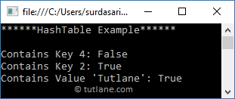
Hashtable htbl = new Hashtable();
htbl.Add("msg", "Welcome");
htbl.Add("site", "Tutlane");
htbl.Add(1, 20.5f);
htbl.Add(2, 10);
htbl.Add(3, 100);
Console.WriteLine("Contains Key 4: {0}", htbl.Contains(4));
Console.WriteLine("Contains Key 2: {0}", htbl.ContainsKey(2));
Console.WriteLine("Contains Value 'Tutlane': {0}", htbl.ContainsValue("Tutlane"));

Slide 18
SortedList
What is SortedList in C#?
The Non-Generic SortedList Collection Class in C# represents a collection of key/value pairs that are sorted by the keys and are accessible by key and by index. By default, it sorts the key/value pairs in ascending order.
SortedList sortedList = new SortedList();

Slide 19
SortedList sortedList = new SortedList();
sortedList.Add(1, “One”);
sortedList.Add(3, “Three”);
SortedList sortedList = new SortedList
{
{ 1, “One” },
{ 3, “Three” }
};
Console.WriteLine($”Key: 1, Value: {sortedList[1]}”);
Console.WriteLine($”Key: 2, Value: {sortedList[2]}”);
Console.WriteLine($”Key: 3, Value: {sortedList[3]}”);
Console.WriteLine($”Key: 1, Index: 0, Value: {sortedList.GetByIndex(0)}”);
Console.WriteLine($”Key: 2, Index: 1, Value: {sortedList.GetByIndex(1)}”);
Console.WriteLine($”Key: 3, Index: 2, Value: {sortedList.GetByIndex(2)}”);

Slide 20
for (int x = 0; x < sortedList.Count; x++)
{
Console.WriteLine($”Key: {sortedList.GetKey(x)}, Value: {sortedList.GetByIndex(x)}”);
}
foreach (DictionaryEntry item in sortedList)
{
Console.WriteLine($”Key: {item.Key}, Value: {item.Value}”);
}

Slide 21
//Creating sortedList Collection
SortedList sortedList = new SortedList();
//Adding Elements to SortedList using Add Method
//Key type going to be same
sortedList.Add(1, "One");
sortedList.Add(5, "Five");
sortedList.Add(4, "Four");
sortedList.Add(2, "Two");
sortedList.Add(3, "Three");
Console.WriteLine("Accessing SortedList using For loop");
for (int x = 0; x < sortedList.Count; x++)
{
Console.WriteLine($"Key: {sortedList.GetKey(x)}, Value: {sortedList.GetByIndex(x)}");
}
Console.WriteLine("\nAccessing SortedList using For Each loop");
//Accessing SortedList using For Each loop
foreach (DictionaryEntry item in sortedList)
{
Console.WriteLine($"Key: {item.Key}, Value: {item.Value}");
}

Slide 29
MiddleWare
DB
UI
.NET/MiddleWare
DB
UI

